Slide 1
MagLIF - Magnetic Fusion, Inertial Fusion and the Middle Ground
Gabriel Shipley
Spring 2016
PHYC 430 – Intro To Solid State Physics
Instructor: James Thomas

Slide 2
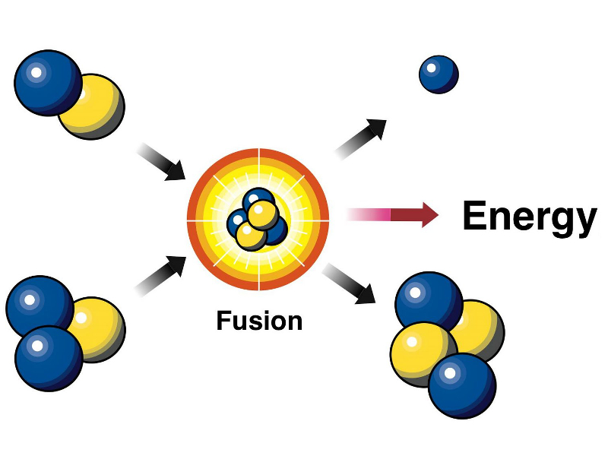
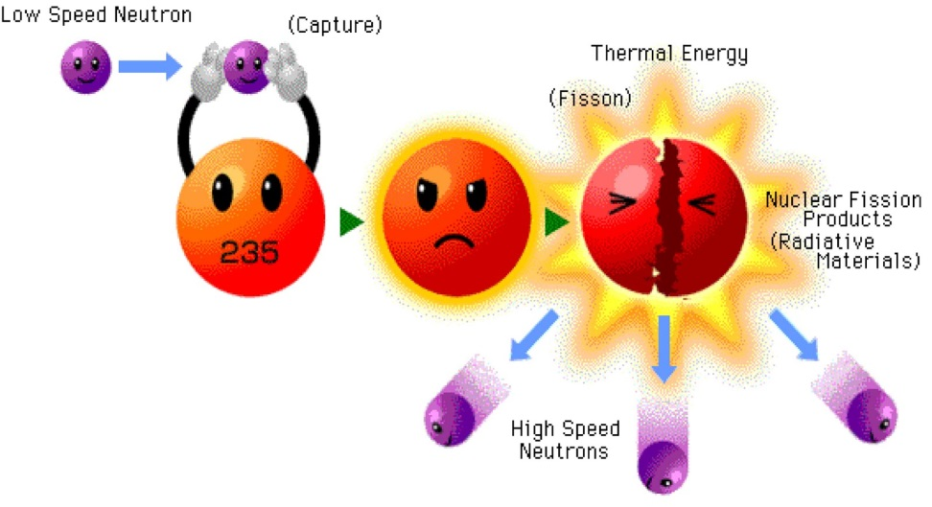
Fission vs. Fusion

Slide 3
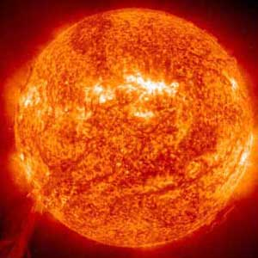
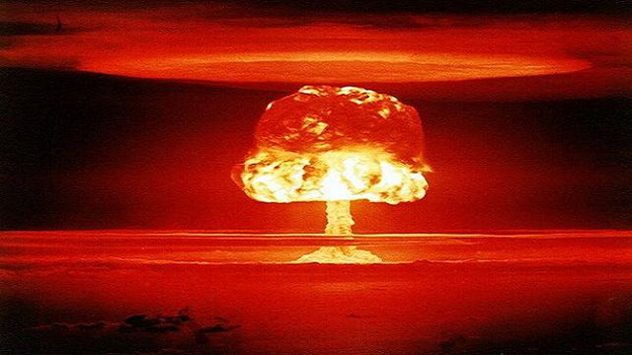
What is fusion?
Light nuclei fuse together to produce a heavier nucleus → This heavier nucleus has higher binding energy per nucleon → ENERGY IS RELEASED!
If light nuclei have lower binding energy per nucleon, why doesn’t fusion happen spontaneously all around us?

Slide 4
What do you need?
High Temperature - Constituents need to move quickly enough (thermal motion) to react.
High Pressure - Constituents need to be close enough to each other
T ~ 25 keV → approx. 11,000 K/eV → This is 300 million K !
Sun’s core temperature is approx. 27 million K.
  Tunneling through Coulomb barrier (gravity confines fusion fuel particles for long enough that they can tunnel).

Slide 5
Lawson Criterion: What is ignition?
Heat loss due to radiation and diffusion of particles is balanced by the heat of the products of the fusion reaction
  Neutrons and alpha particles in DT fusion
Ignition is crucial for fusion reactors to “break even” where energy put into the plasma is less than the energy born from the plasma → energy gain → feasible reactor!

Slide 6
Lawson Criterion : nt > 1.5e20 s/m^3
n is the number density of constituents (# of nuclei per m^3)
t is the confinement time
Magnetic Fusion – small n, large t
  1e19 m^-3 (air is 1e25 m^-3)
  seconds/minutes
Inertial Fusion – large n, small t
  1e30 m^-3 (lead is 3e28 m^-3) → 20-100 times more dense than lead
  nanoseconds

Slide 7
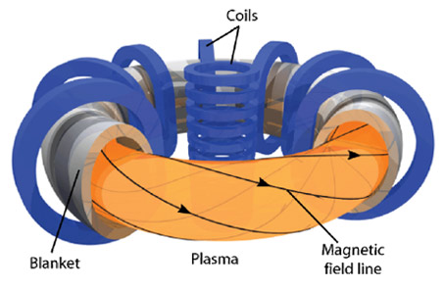
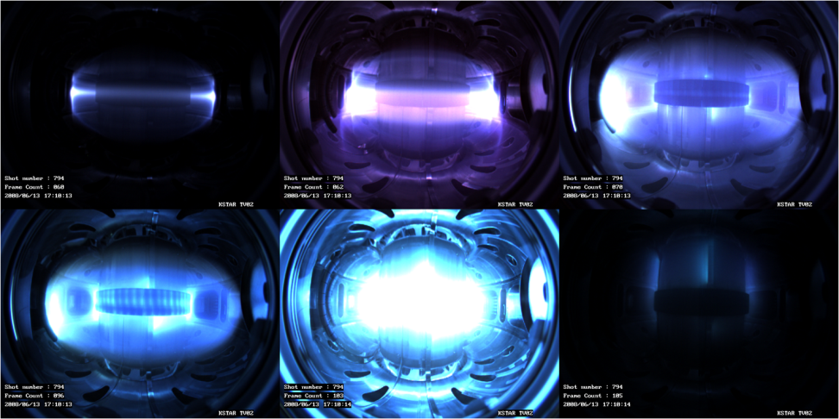
Magnetic Fusion – A Brief Summary
Magnetic fields are employed to contain plasma (a fluid composed of charged particles).
Heat is provided by injection of beams (this is complicated) and self heating → energy produced by fusion and Ohmic heating due to electrons flowing in plasma.

Slide 8
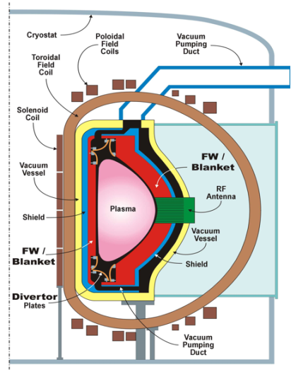
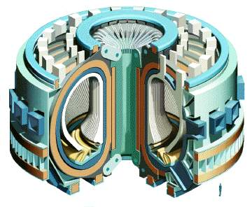
Magnetic Fusion - continued
Steady State Operation
  Similar to fission reactors in this sense
Use of Superconducting Magnets
No radioactive waste...
  High neutron flux activates surrounding materials

Slide 9

ITER – International Thermonuclear Experimental Reactor
7 entities contributing (EU, US, China, Russia, Japan, South Korea, India)
Cost: $16 billion → still growing
~12 meters tall
~ 5000 mt
Superconducting niobium-tin and niobium-titanium → 41 GJ of stored energy

Slide 10
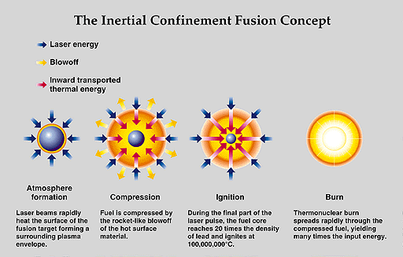
Inertial Confinement Fusion – Concept Basics

Slide 11
In indirect-drive inertial confinement fusion, fuel is heated and compressed in order to produce fusion
Fuel capsule is suspended inside a hohlraum
High Z hohlraum
DT gas
Ablator with DT ice layer

Slide 12
In indirect-drive inertial confinement fusion, fuel is heated and compressed in order to produce fusion
Fuel capsule is suspended inside a hohlraum
Laser beams enter the hohlraum

Slide 13
In indirect-drive inertial confinement fusion, fuel is heated and compressed in order to produce fusion
Fuel capsule is suspended inside a hohlraum
Laser beams enter the hohlraum
Walls are heated to 100’s of eV, plasma forms and radiates soft x-rays

Slide 14
In indirect-drive inertial confinement fusion, fuel is heated and compressed in order to produce fusion
Fuel capsule is suspended inside a hohlraum
Laser beams enter the hohlraum
Walls are heated to 100’s of eV, plasma forms and radiates soft x-rays
Capsule material ablates

Slide 15
In indirect-drive inertial confinement fusion, fuel is heated and compressed in order to produce fusion
Fuel capsule is suspended inside a hohlraum
Laser beams enter the hohlraum
Walls are heated to 100’s of eV, plasma forms and radiates soft x-rays
Capsule material ablates
Fuel implodes, stagnates, and fuses

Slide 16
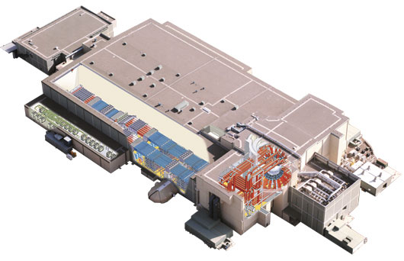

Pulsed-power systems are energy efficient.
Z: ~0.2 million ft³
Prime Energy ~ 22 MJ
Energy to load ~3 MJ
X-ray energy ~3 MJ
NIF: ~24 million ft³
Prime Energy ~ 400 MJ
Energy ~ 1.9 MJ laser (blue)
X-ray Energy ~1.6 MJ

Slide 17
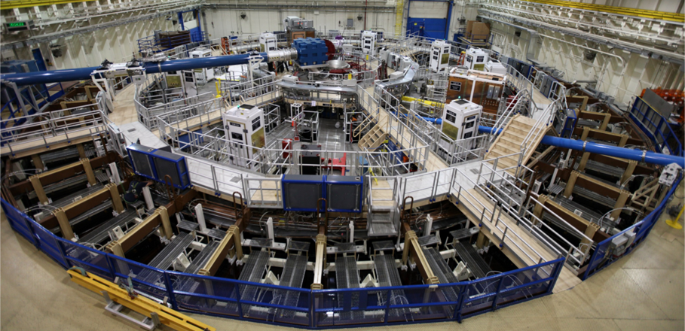
We conduct these experiments on the Z machine, the world’s largest pulsed power system
22 MJ stored energy, 3 MJ delivered to target
Up to 26 MA peak current with a 100 ns risetime
Up to 50 MG B-field, up to 100 Mbar pressure

Slide 18
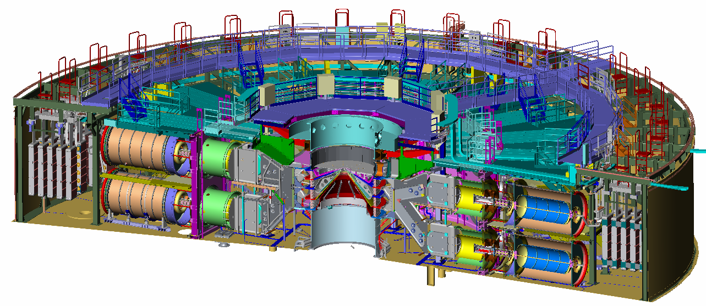
Z works by compressing electromagnetic energy in time and space
67 TW
33 m
77 TW
20TW

Slide 19
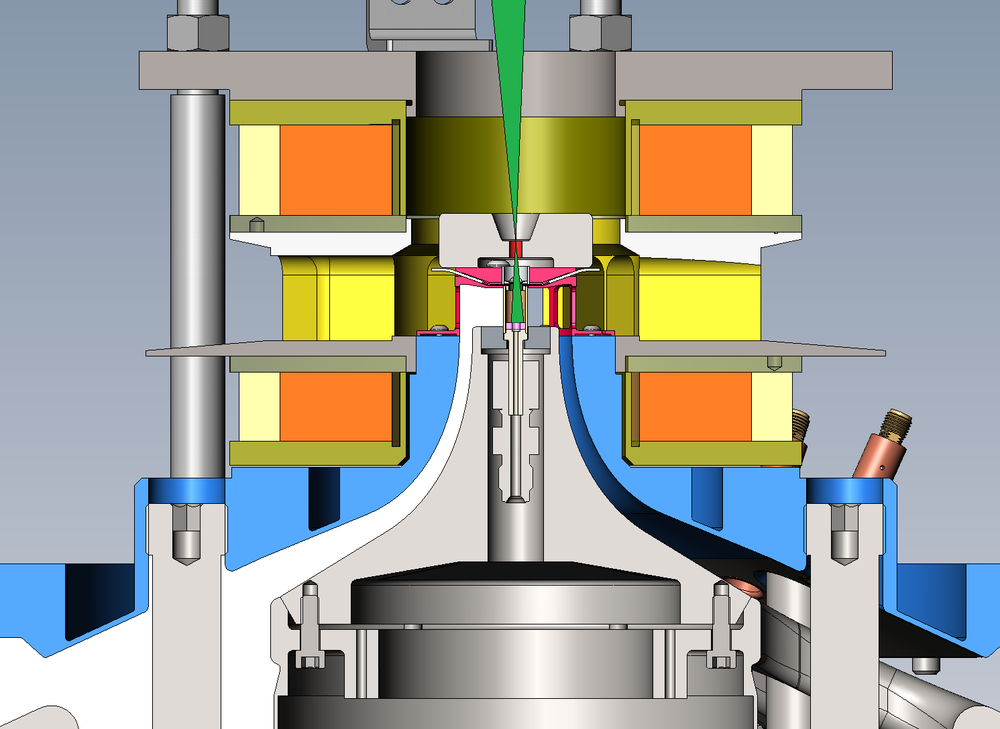
Prior to the integrated experiments, a series of focused experiments were conducted to test all of the critical components of MagLIF
Laser preheat
Applied magnetic field
Liner
Modified power flow

Slide 20
Experiments utilize D2 gas fill at approximately 0.7 mg/cc (60 PSI)
Primary reactions
Secondary reactions
Triton may still retain fraction of birth energy when reacting
D
D
He3
n
2.45 MeV
D
D
P
T
1.01 MeV
D
T
He4
n
14.1 MeV

Slide 21
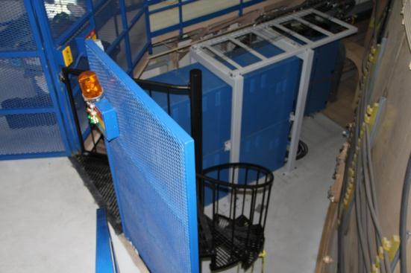
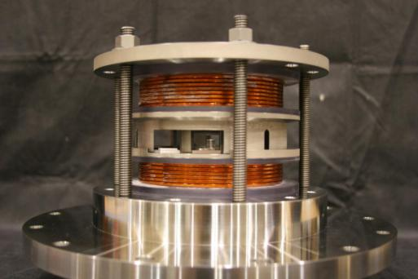
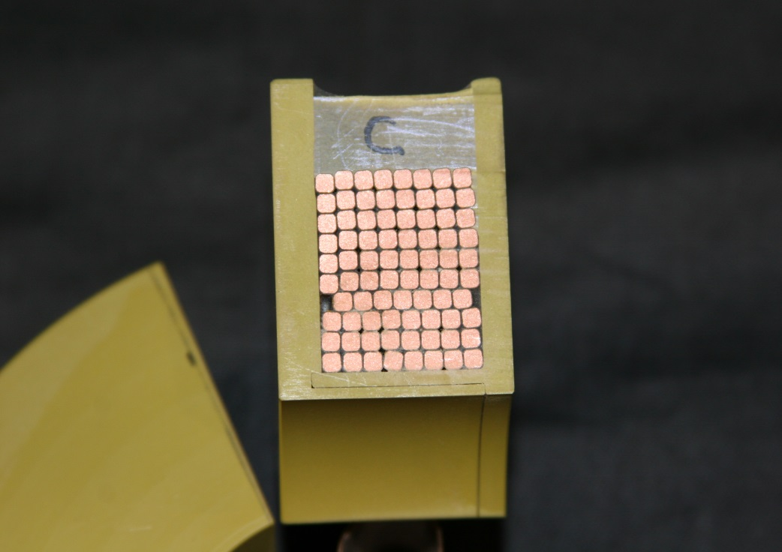
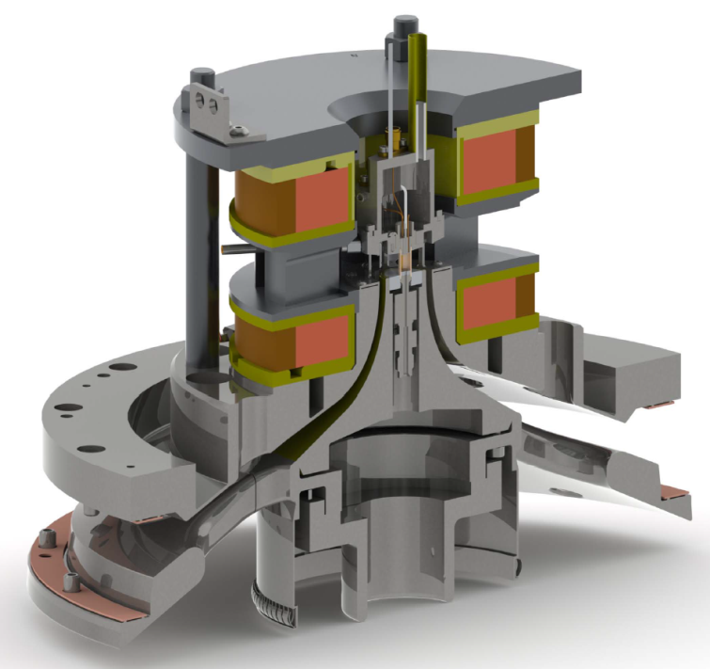
We developed the capability to apply uniform, pulsed magnetic fields to cm-scale targets
B_{z}
Magnets
Applied B-field on Z
Capacitor bank: 900 kJ, 8 mF, 15 kV
Full diagnostic access coils: up to 10 T
Limited diagnostic access coils: 15-20 T
No diagnostic access coils: 25-30 T
Target
Extended power feed

Slide 22
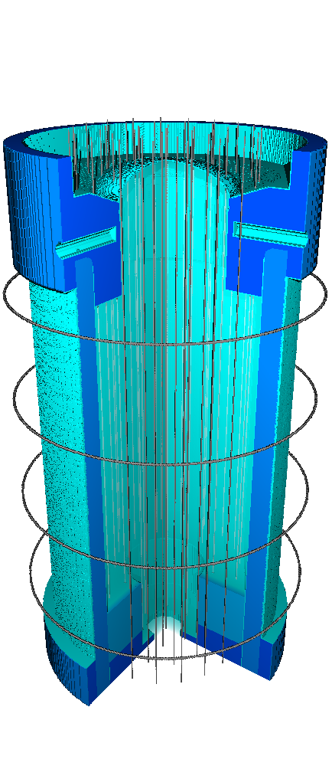
MagLIF has three stages: Stage 1 is Magnetization
Start with a thick metal liner containing gaseous fusion fuel
An axial magnetic field is applied slowly so the field can diffuse through conductors
S. A. Slutz et al., Phys. Plasmas, 17 056303 (2010).

Slide 23
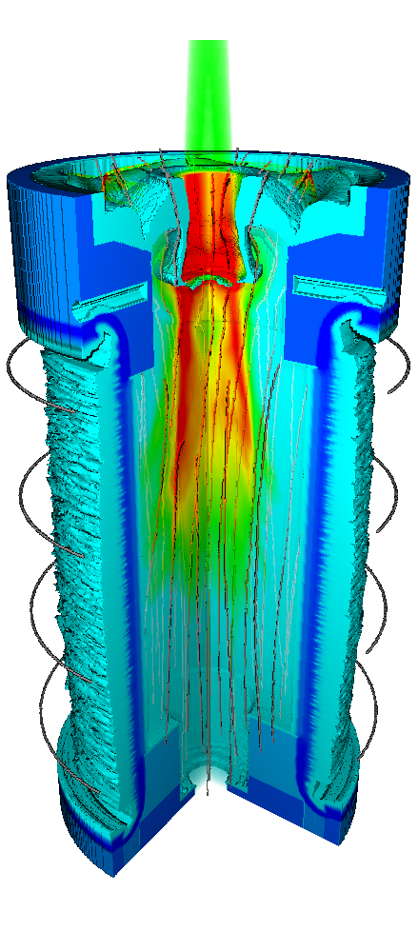
MagLIF has three stages: Stage 2 is Laser heating
A laser enters the target axially
The laser heats the fuel through inverse bremsstrahlung absorption
The magnetic field insulates the warm gas from the cool liner
S. A. Slutz et al., Phys. Plasmas, 17 056303 (2010).

Slide 24
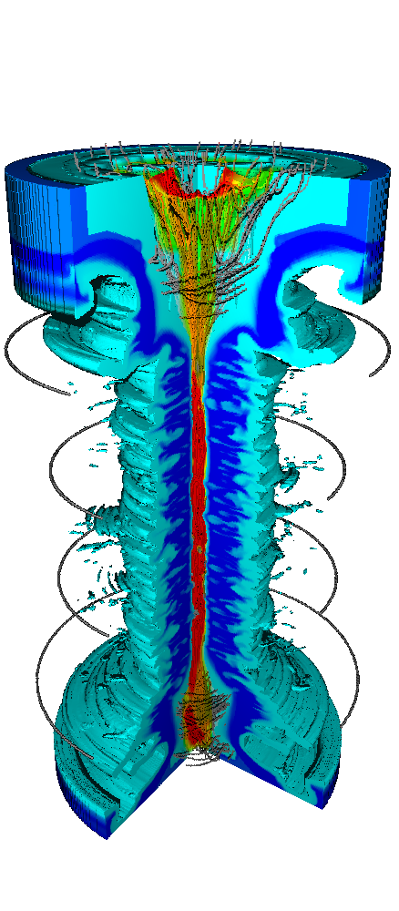
MagLIF has three stages: Stage 3 is Compression
Current flowing on the outside of the target squeezes the liner which compresses the fuel and magnetic field
The fuel heats through near adiabatic compression to fusion relevant temperatures
current
S. A. Slutz et al., Phys. Plasmas, 17 056303 (2010).

Slide 25
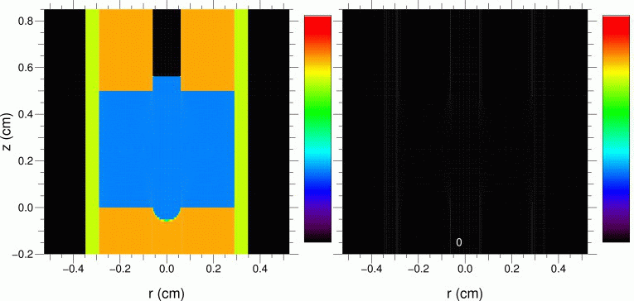
Putting it all together…
Density
Temperature
A. B. Sefkow, et al., Phys. Plasmas, 21 072711 (2014).

Slide 26
Questions?

Slide 27
Back-up slides

Slide 28

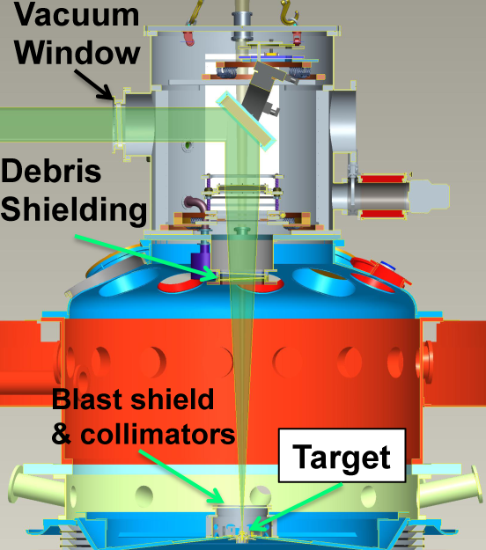
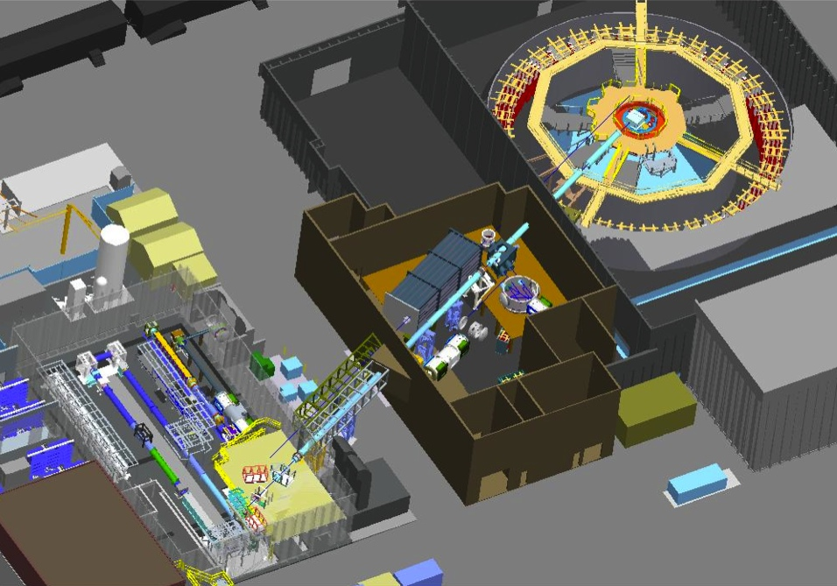

The Z Beamlet laser was diverted from the backlighter diagnostic to heat the fuel in MagLIF
2ω Nd:glass (527 nm)
1 TW, up to 4 kJ,
up to 6 ns pulse length

Slide 29
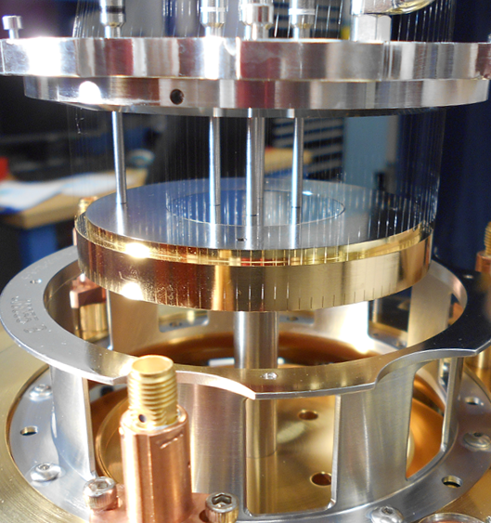
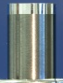

The transition from wire arrays to MagLIF targets was a nontrivial task
70 mm wire array
5.6 mm liner
10 x magnification
Endcap
Be liner
Smaller targets with tighter tolerances
Beryllium machining capability

Slide 30
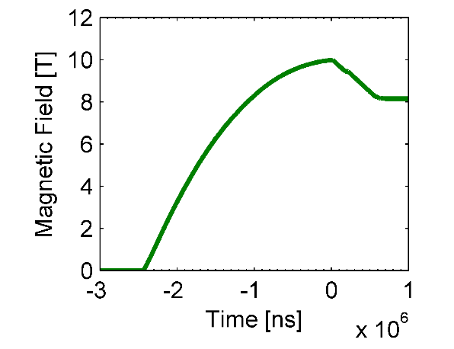
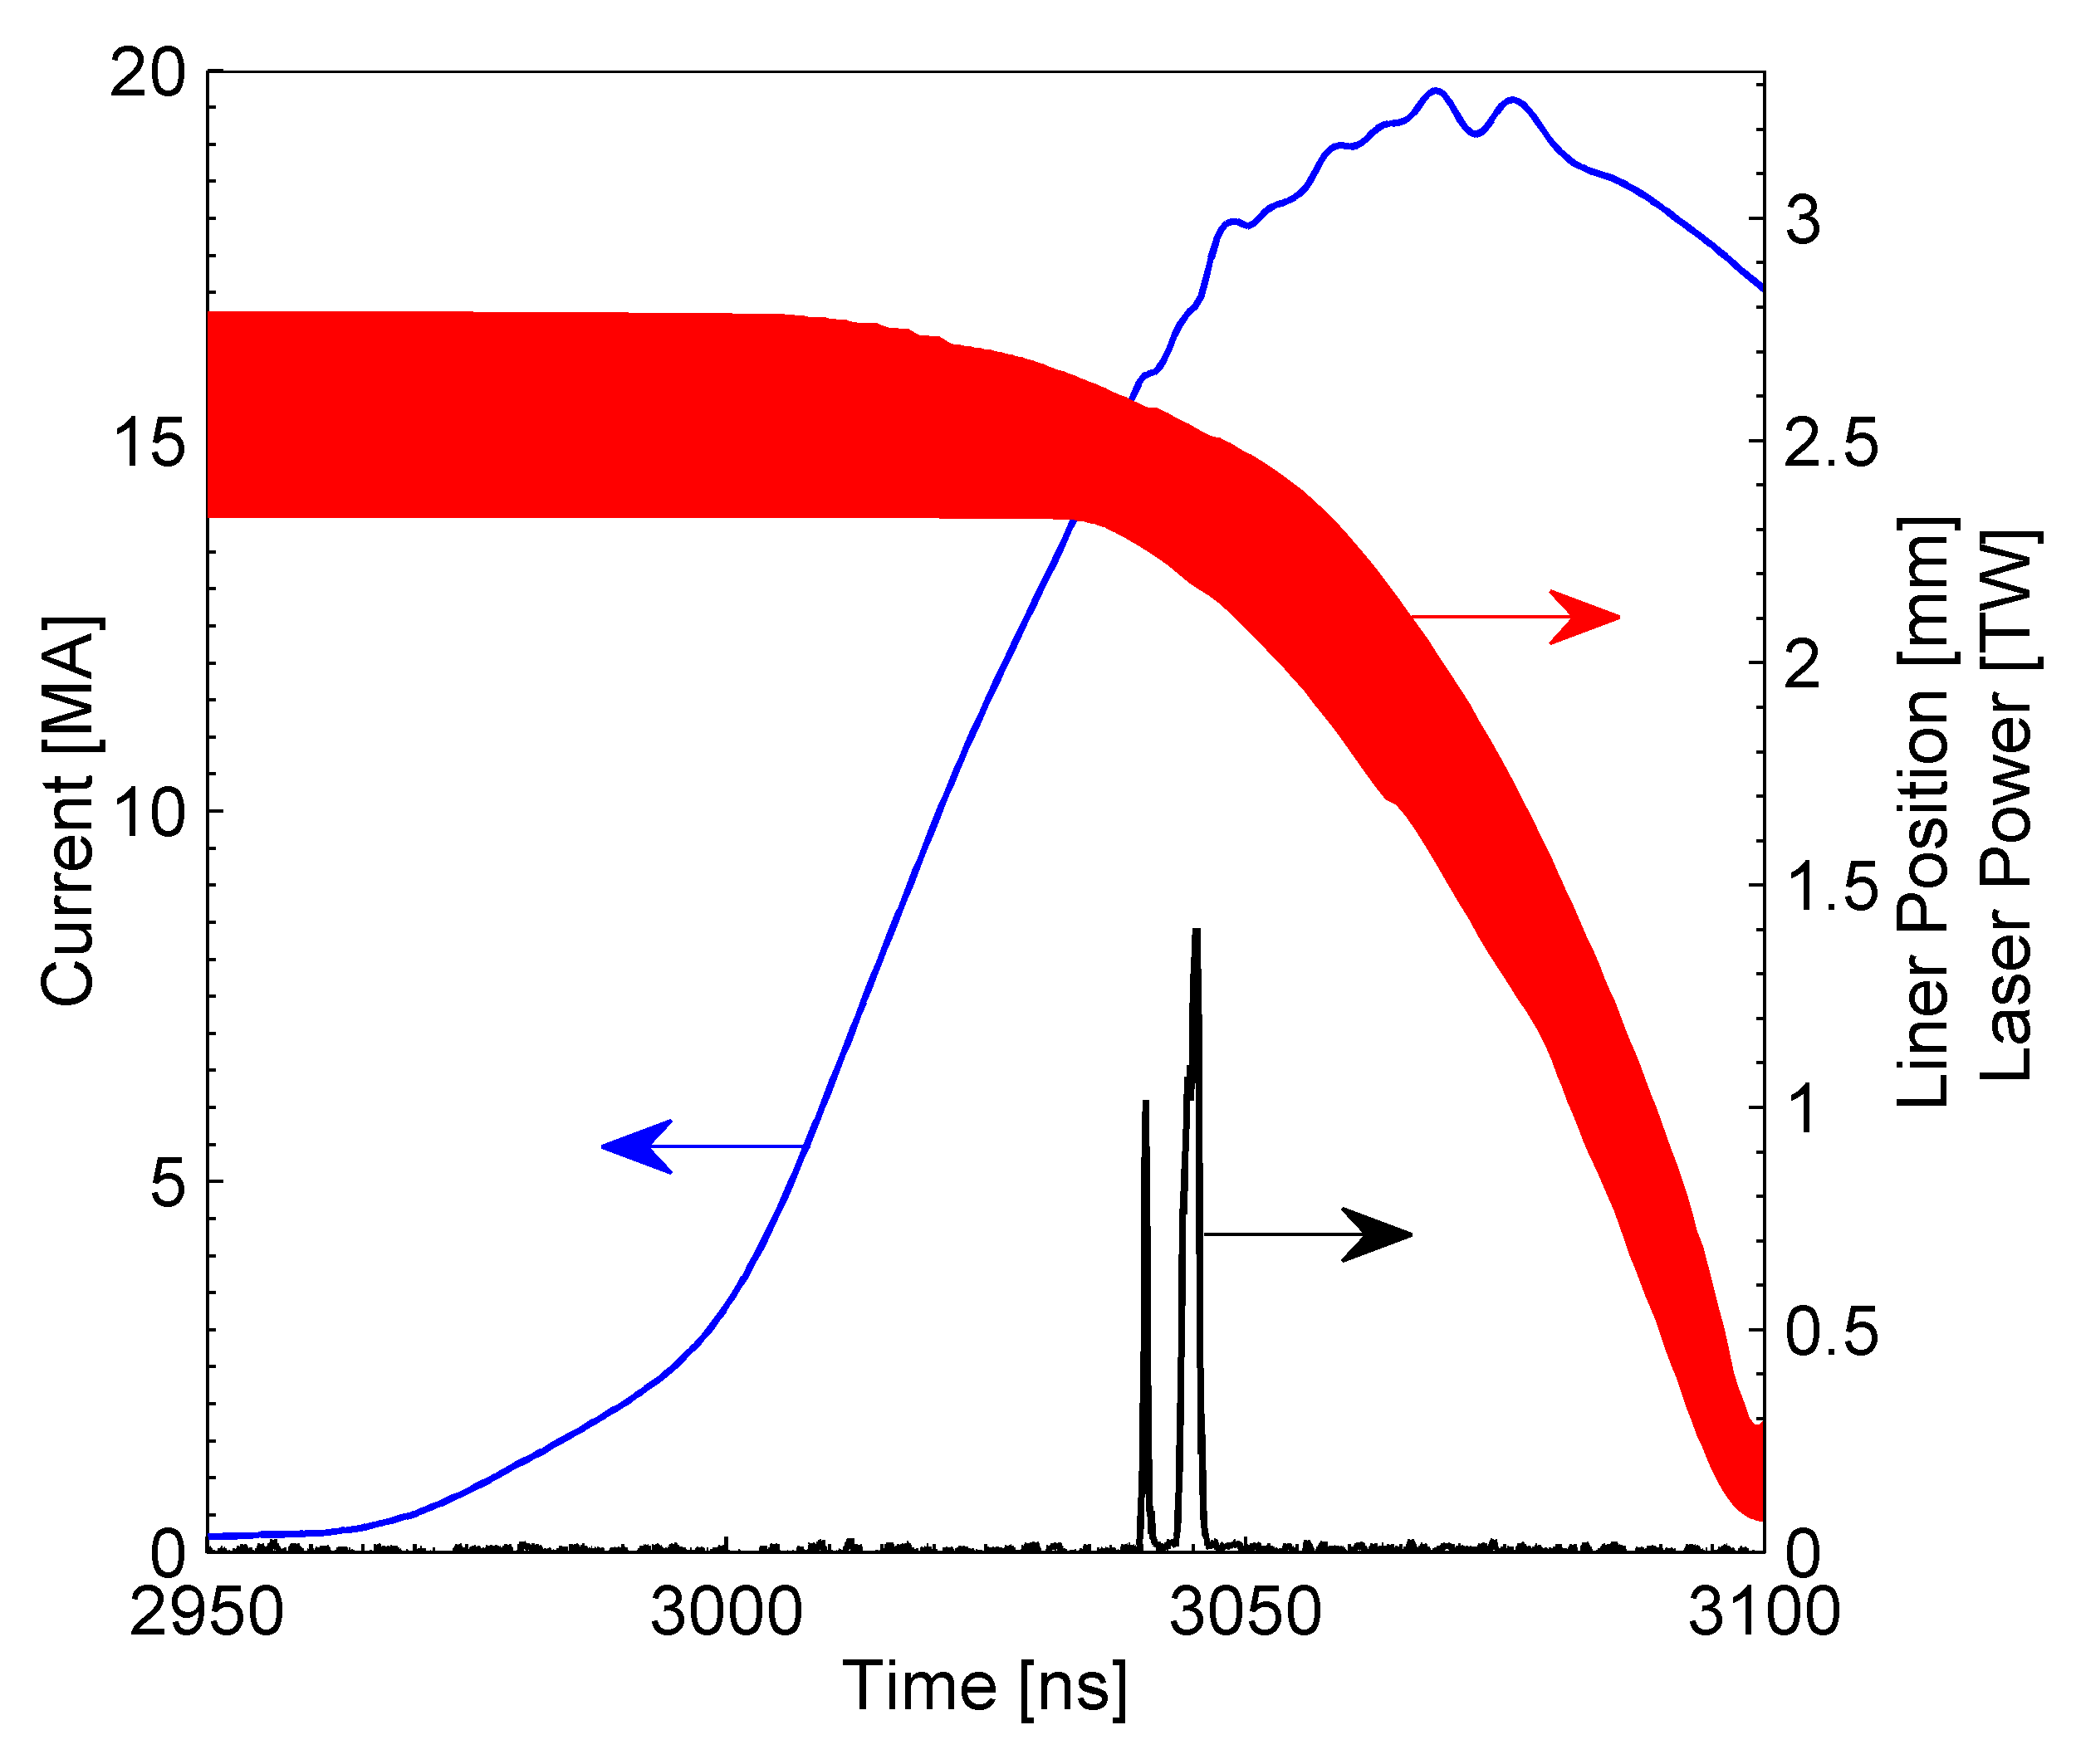
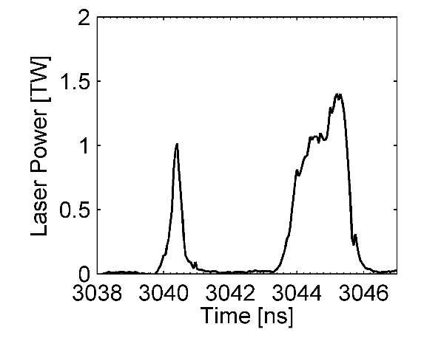
Experiments were conducted at B = 10 T, I = 19 MA, and Laser = 2.5 kJ
Time of experiment
Laser energy is split into 2 pulses:
1st pulse intended to destroy LEH
2nd pulse intended to heat fuel
Magnetic field risetime is approximately 2 ms
B is constant over the timescale of the experiment
2 kJ
0.5 kJ
Peak current is 19 MA
Magnetic field is 10 T
Total laser energy is 2.5 kJ
M. R. Gomez, et al., submitted to Phys. Rev. Lett. (2014).

Slide 31
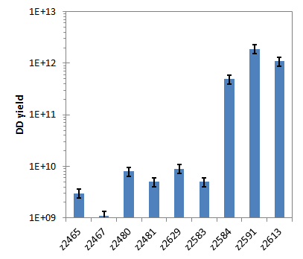
Thermonuclear DD yields in excess of 10¹² were observed in experiments with laser and B-field
High yields were only observed on experiments incorporating both applied magnetic field and laser heating
A series of experiments without laser and/or B-field produced yields at the background level of the measurement
Result of z2583 is not well understood at this time
Null
B-field
B-field and Laser

Slide 32
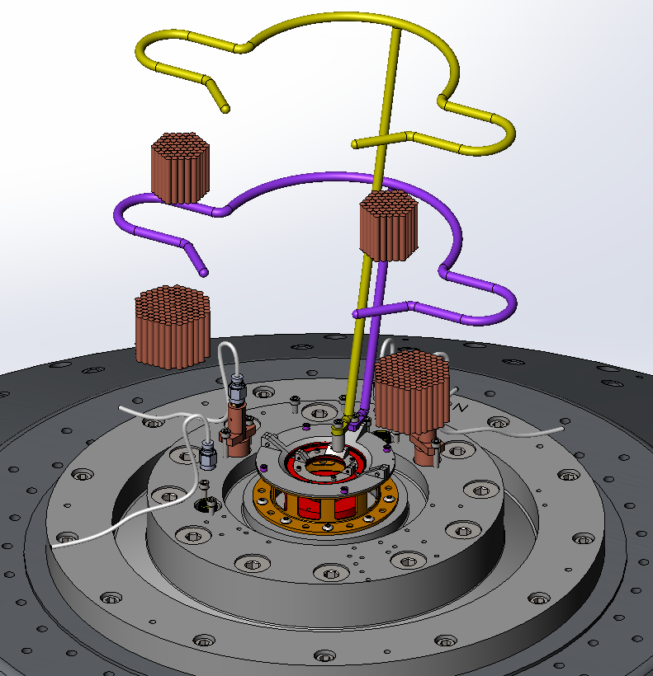
Over 5 years we transitioned from wire arrays to solid liners and added both an axial magnetic field capability and a laser heating capability
Laser heating
B-field coils
Raised load
Several years and dozens of experiments to evaluate the stability of cylindrical liners 2009-present
Modified power flow geometry to accommodate B-field coils tested in 2012
Applied B-field capability was first implemented in early 2013
Vacuum final optics assembly completed summer of 2013
First integrated experiments completed fall of 2013

Slide 33
Magnetic flux compression demonstrated through secondary neutron yield and spectra
Low B
In a high aspect ratio cylinder the effective areal density of the fuel is approximately the radial areal density
For ρR ~ 2 mg/cm²
DD/DT yield ratio > 1000
6 mm
Tritons
0.1 mm
ρR ~ 2 mg/cm²
ρZ ~ 200 mg/cm²
P. F. Schmit, P. F. Knapp et al., Phys. Rev. Lett. 113, 155004 (2014).

Slide 34
Magnetic flux compression demonstrated through secondary neutron yield and spectra
Low B
High B
In a highly magnetized cylinder the effective areal density of the fuel becomes much larger because the tritons cannot escape radially.
For ρR ~ 2 mg/cm²
DD/DT yield ratio > 1000
(unless significantly magnetized)
We observed DT yields as high as 5e10
DD/DT ~ 50-100
6 mm
Tritons
0.1 mm
ρR ~ 2 mg/cm²
ρZ ~ 200 mg/cm²
P. F. Schmit, P. F. Knapp et al., Phys. Rev. Lett. 113, 155004 (2014).

Slide 35
An alternative ICF concept utilizing magnetically driven implosions is being developed at Sandia
The Z machine stores 22 MJ in its capacitor banks
Approximately 500 kJ is delivered to the target
Nearly 100 kJ is put into the fuel
  0.4% efficient – significant improvement via direct magnetic coupling
  This is about 2 orders of magnitude more efficient and around an order of magnitude more energy delivered to the fuel
These experiments are still in their infancy though
  Other Magneto-Inertial Fusion concepts have 10-100x longer time scales, 100-1000x lower initial density, and different B-field geometry
  MagLIF concept proposed around 2009
  First fully-integrated experiments conducted in late 2013
  We are still identifying the advantages and disadvantages of the concept

Slide 36
Why should we consider alternate drivers for ICF? Consider the energy at various stages in NIF
Initial stored energy 422 MJ
192 frequency-tripled laser beams 1.9 MJ
Hohlraum radiates soft x-rays 1.6 MJ
Capsule absorbs 150 kJ
Fuel absorbs 10 kJ
  0.002% efficient
Note that DPSS lasers are more efficient
Order of 10% as opposed to 1%

